Slide 1
THasyINKnc: Multi-threading in Microsoft .Net By Eric Burcham
HDNUG Meeting #159
July 9, 2015
Tonight’s Event Sponsored By:
Curtis Schlak - http://curtis.schlak.com

Slide 2
Housekeeping
Wireless:
SSID: msftopen
Restrooms

Slide 3
Out of Work?
HDNUG can help!
Free 30 day subscription to Pluralsight
Send email to jsawyer@hdnug.org
Connect with recruiters and jobs on HDNUG’s LinkedIn group

Slide 4
Fun Fact of the Month
Who invented punch cards?

Slide 5
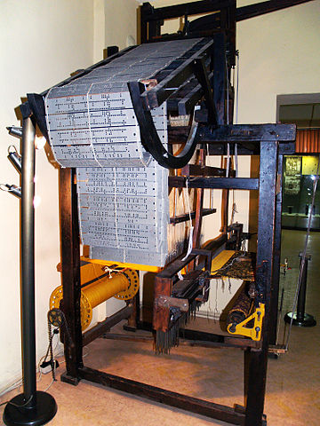
Fun Fact of the Month
Joseph Marie Jacquard
born July 7, 1752
Invented the Jacquard loom, which used replaceable punched cards to control a sequence of operations (1801)
Babbage knew of this and planned on using it for his Analytical Engine
Herman Hollerith took this a step further for the 1890 US Census
Punched cards remained in use into the 80’s.
"Hand-driven-jacquard-loom" by Edal Anton Lefterov - Own work. Licensed under CC BY-SA 3.0 via Wikimedia Commons - https://commons.wikimedia.org/wiki/File:Hand-driven-jacquard-loom.jpg#/media/File:Hand-driven-jacquard-loom.jpg

Slide 6
Microsoft News
FREE TRAINING:
Microsoft Virtual Academy
www.microsoftvirtualacademy.com

Slide 7
A word from our sponsor …
Curtis Schlak http://curtis.schlak.com

Slide 8



Coming Soon to a Theatre Near You
Tuesday, August 11, 2015
8am-5pm
Studio Movie Grill City Center
Register now AgileDotNext.com
Get 10% off by entering IEUGfriends

Slide 9
Intermission
10 Minutes
Last chance to buy extra door prize tickets!

Slide 10
Tonight’s Talk
Thinkasync : multithreading in Microsoft .net By eric burcham

